Slide 1
Job Portal Project
Presented by :
Mohamed Amine Ben Hmida

Slide 2

HELLO!
I am Mohamed
I am here to introduce my new project
The Job Portal Website JP LIGHTHOUSE

Slide 3
Overview
1
Finding jobs that best suit their interests and skill sets is challenging for job seekers.
Job Portal is the solution where the recruiter, as well as the job seeker, meet aiming at fulfilling their requirement.

Slide 4
Objective :
The objective of the web as well as the android application is to provide flexibility to job seekers by providing the functionalities of both job search and job application in a single application.
In addition, this application provides an effective means for employers to post job vacancies and view the job applications by interested applicants in a single application. Employers can also view the reviews provided by the jobseekers.

Slide 5
What to expect?
Profil
People can register as job seekers, build their profiles, and look for jobs matching their skill sets.
Resume
Users can upload their existing resumes. If they do not have one, they should be able to fill out a form and have a resume built for them.
Hunt Talent
Companies can register, post jobs, and search for job seeker profiles.
Apply
People can apply directly to posted jobs.
Filter
Registered users should be able to search for jobs and filter the results based on location, required skills, salary, experience level, etc.
Contact
Company representatives can view a list of job applicants and can contact them, initiative an interview, or perform some other action related to their post.

Slide 6
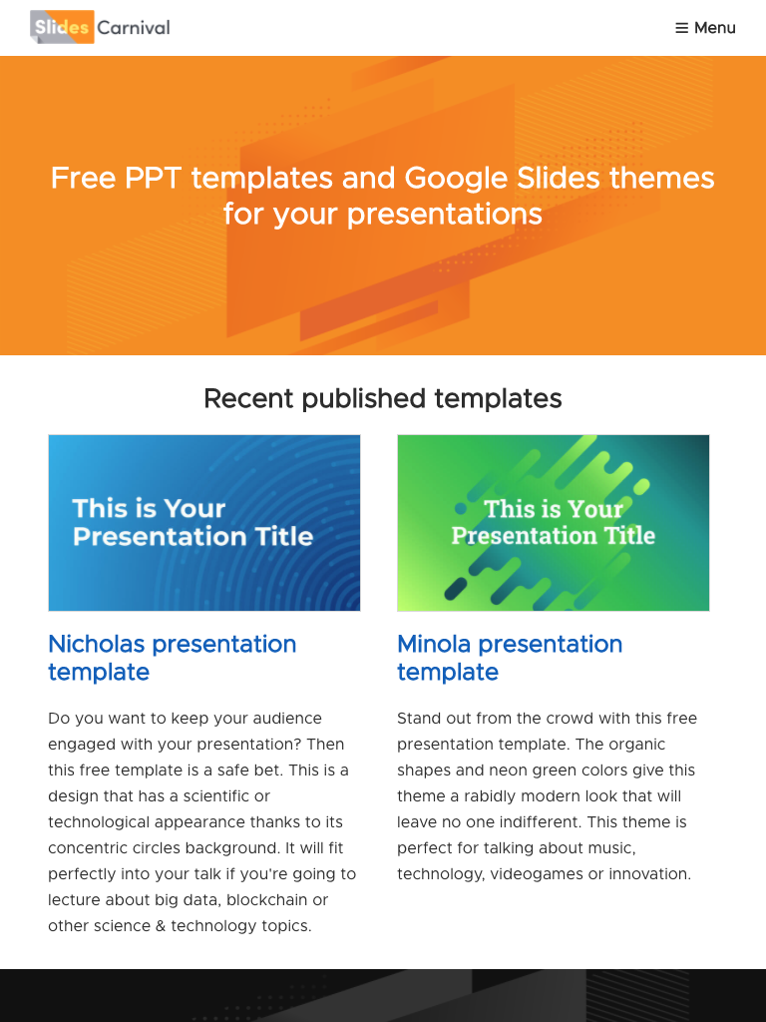
System Design
Systems design is the process of defining the architecture, components, modules, interfaces, and data for a system to satisfy specified requirements.
System designs are modeled using UML
the standard object-oriented analysis and design language. The UML is a collection of
Diagrams and a standard set of notations for specifying and visualizing various aspects such as requirements and design of software systems.

Slide 7
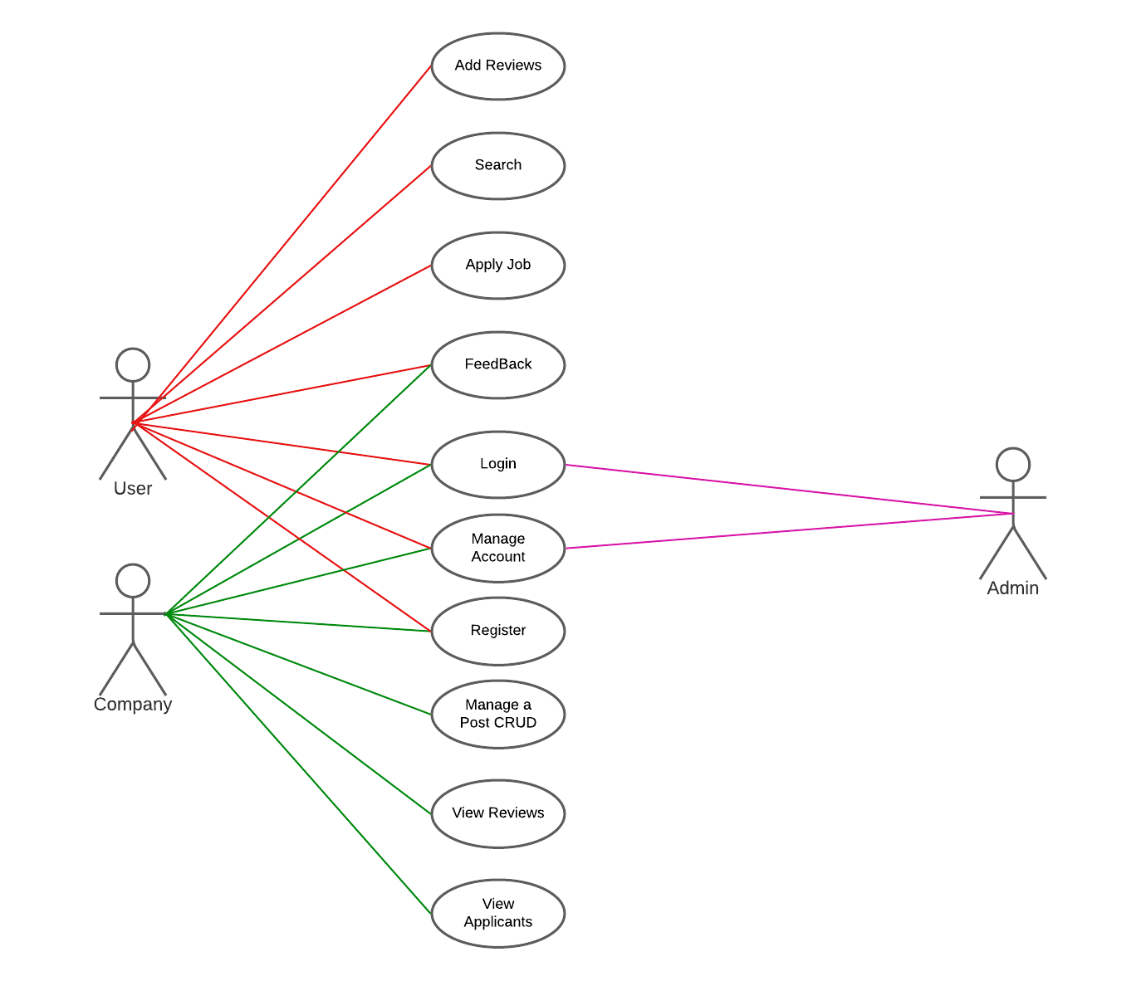
Use Case Diagram

Slide 8
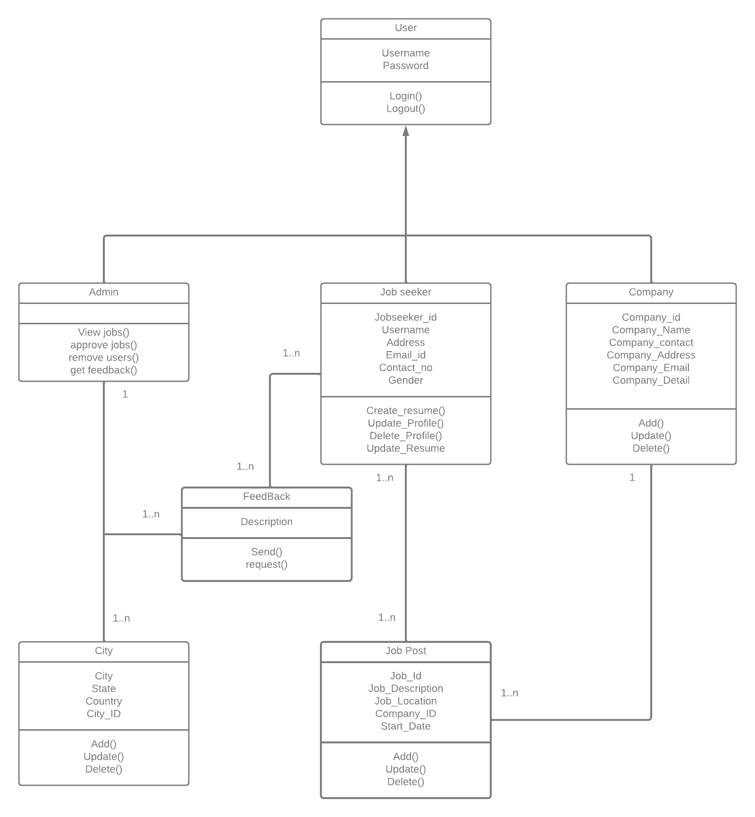
Class Diagram

Slide 9
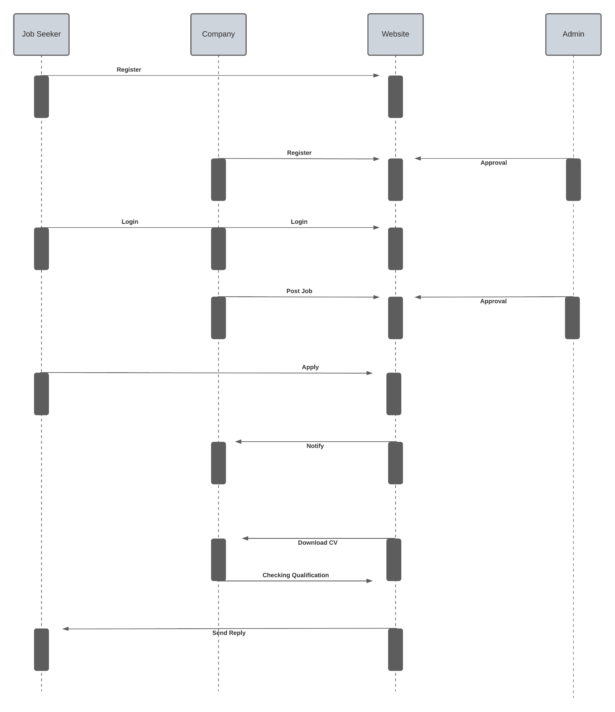
Sequence Diagram

Slide 10
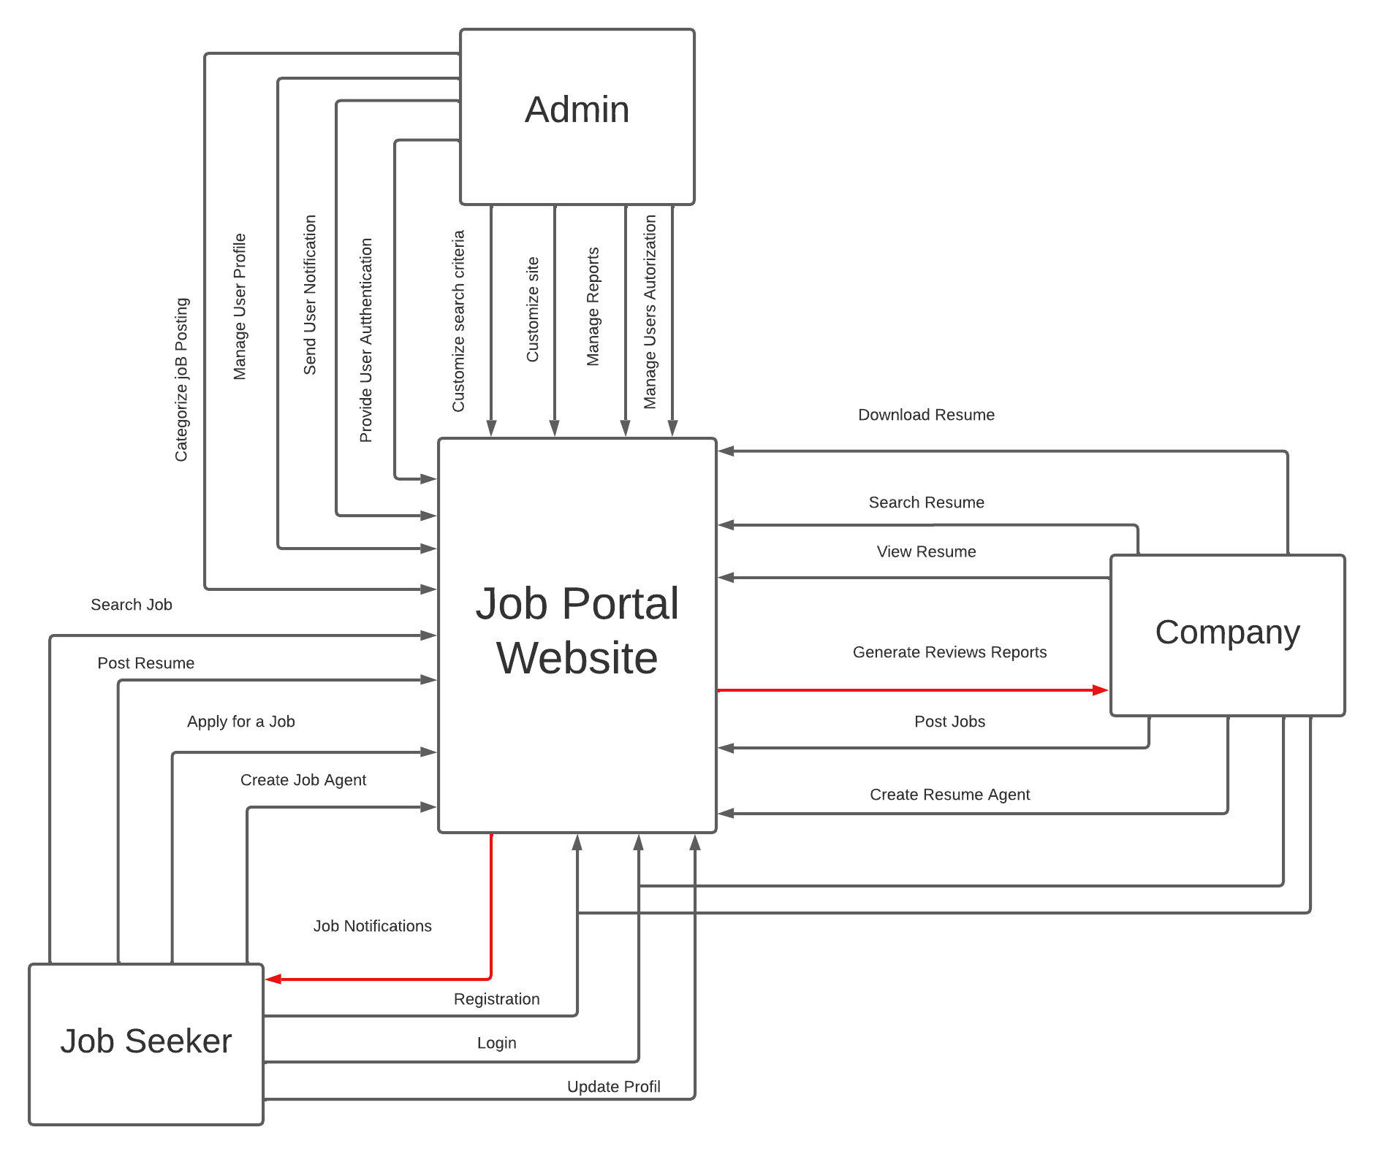
Activity Diagram

Slide 11
THANKS!
Any questions?
You can find me at:
https://github.com/MohamedAminebenhmida
Mohamedaminebenhmida4@gmail.com

